Slide 1
Leveraging Title-Abstract Attentive Semantics for Paper Recommendation
AAAI

Slide 2
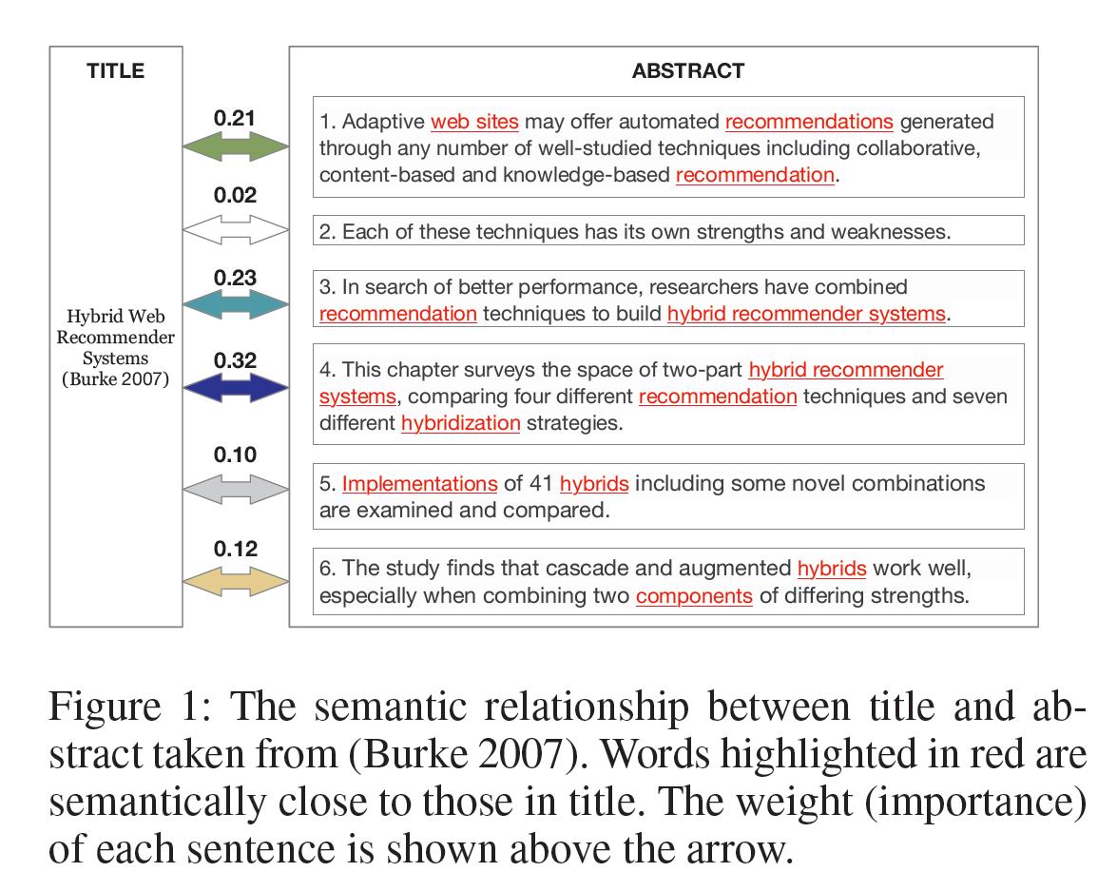
Introduction

Slide 3
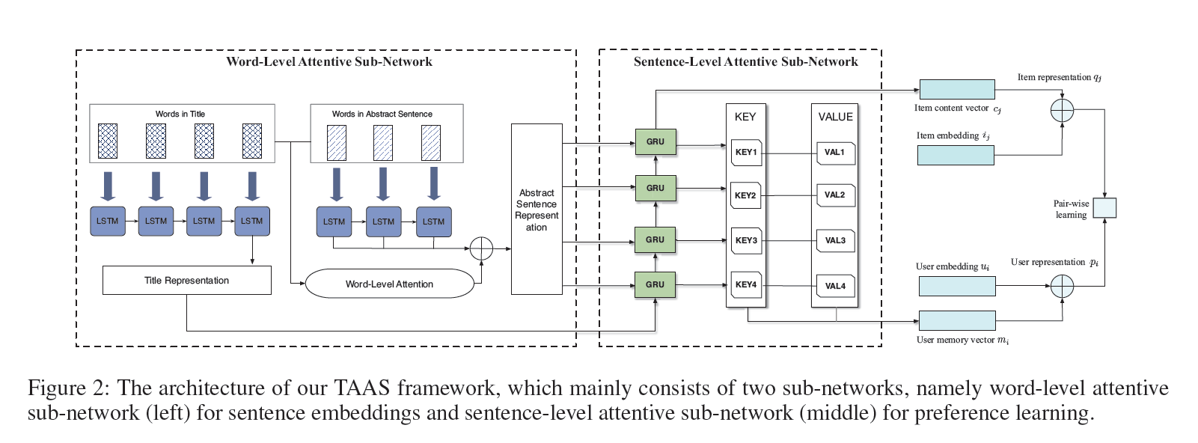
Methods

Slide 4



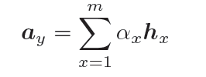

Methods
标题
摘要

Slide 5


Methods

Slide 6
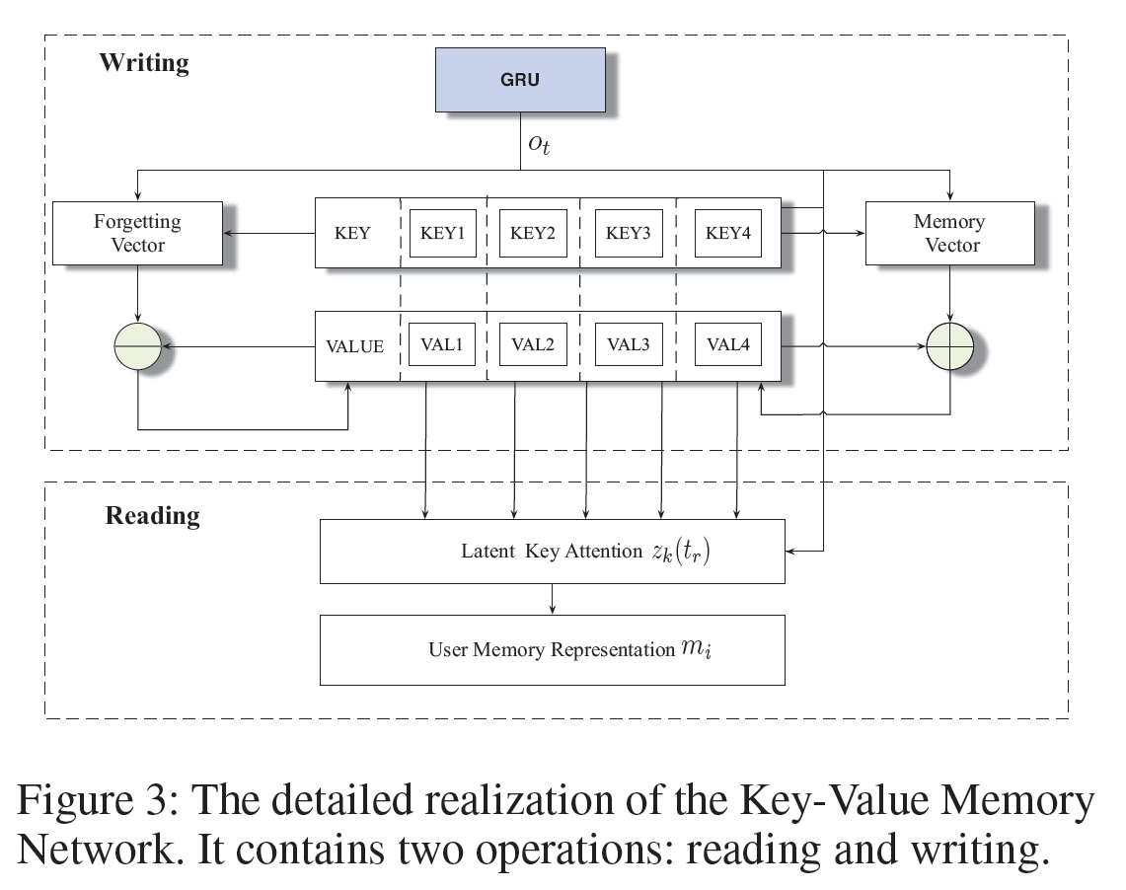







Methods

Slide 7



Methods

Slide 8

Experiment

Slide 9

Experiment

